Slide 1
COMPLETE
BUSINESS
STATISTICS
by
AMIR D. ACZEL
&
JAYAVEL SOUNDERPANDIAN
7th edition.
Prepared by Lloyd Jaisingh, Morehead State University
Chapter 17
Multivariate Analysis
McGraw-Hill/Irwin
Copyright © 2009 by The McGraw-Hill Companies, Inc. All rights reserved.

Slide 2
_{17-<number>}
17
Multivariate Analysis
The Multivariate Normal Distribution
Discriminant Analysis
Principal Components and Factor Analysis
Using the Computer

Slide 3
_{17-<number>}
17
LEARNING OBJECTIVES
After studying this chapter, you should be able to:
Describe a multivariate normal distribution
Explain when a discriminant analysis could be conducted
Interpret the results of a discriminant analysis
Explain when a factor analysis could be conducted
Differentiate between principal components and factors
Interpret factor analysis results

Slide 4
17-2 The Multivariate Normal Distribution
_{17-<number>}
A k-dimensional (vector) random variable X:
  X = (X₁, X₂, X₃..., X_{k})
A realization of a k-dimensional random variable X:
  x = (x₁, x₂, x₃..., x_{k})
A joint cumulative probability distribution function of a k-dimensional random variable X:
  F(x₁, x₂, x₃..., x_{k}) = P(X₁≤x₁, X₂≤x₂,..., X_{k}≤x_{k})

Slide 5
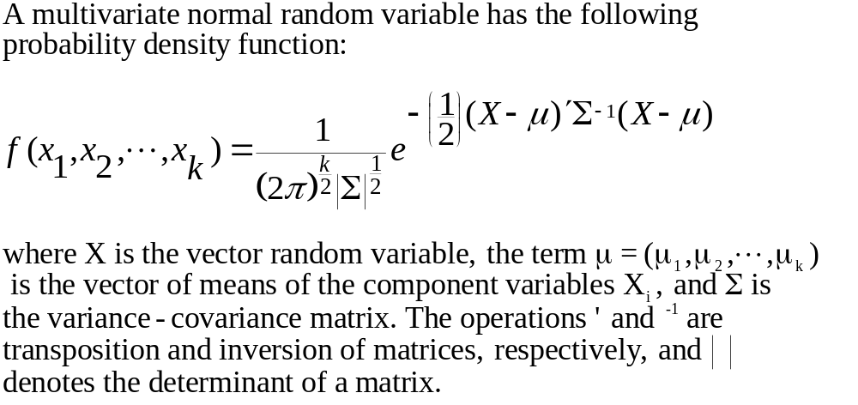
The Multivariate Normal Distribution
_{17-<number>}

Slide 6
Picturing the Bivariate Normal Distribution
_{17-<number>}
f(x₁,x₂)
x₂
x₁

Slide 7
17-3 Discriminant Analysis
_{17-<number>}
In a discriminant analysis, observations are classified into two or more groups, depending on the value of a multivariate discriminant function.
As the figure illustrates, it may be easier to classify observations by looking at them from another direction. The groups appear more separated when viewed from a point perpendicular to Line L, rather than from a point perpendicular to the X₁ or X₂ axis. The discriminant function gives the direction that maximizes the separation between the groups.
X₂
Group 1
μ₁
μ₂
Group 2
Line L
X₁

Slide 8
The Discriminant Function
_{17-<number>}
The form of the estimated predicted equation:
D = b₀ +b₁X₁+b₂X₂+...+b_{k}X_{k}
where the b_{i} are the discriminant weights. b₀ is a constant.
The intersection of the normal marginal distributions of two groups gives the cutting score, which is used to assign observations to groups. Observations with scores less than C are assigned to group 1, and observations with scores greater than C are assigned to group 2. Since the distributions may overlap, some observations may be misclassified.
The model may be evaluated in terms of the percentages of observations assigned correctly and incorrectly.
Group 1
Group 2
C
Cutting Score

Slide 9
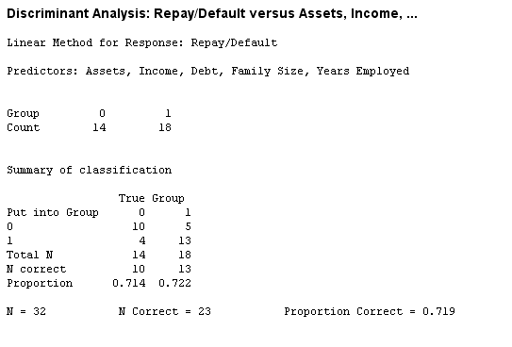
Discriminant Analysis: Example 17-1 (Minitab)
_{17-<number>}

Slide 10
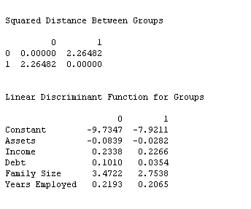
Discriminant Analysis: Example 17-1 (Minitab - continued)
_{17-<number>}

Slide 11
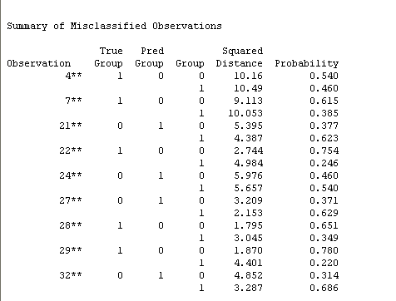
Example 17-1: Misclassified Observations (Minitab – continued)
_{17-<number>}

Slide 12
Example 17-1: SPSS Output (1)
_{17-<number>}
1 0 set width 80
2 data list free / assets income debt famsize job repay
3 begin data
35 end data
36 discriminant groups = repay(0,1)
37 /variables assets income debt famsize job
38 /method = wilks
39 /fin = 1
40 /fout = 1
41 /plot
42 /statistics = all
Number of cases by group
Number of cases
REPAY Unweighted Weighted Label
0 14 14.0
1 18 18.0
Total 32 32.0

Slide 13
Example 17-1: SPSS Output (2)
_{17-<number>}
- - - - - - - - D I S C R I M I N A N T A N A L Y S I S - - - - - - - -
On groups defined by REPAY
Analysis number 1
Stepwise variable selection
Selection rule: minimize Wilks' Lambda
Maximum number of steps.................. 10
Minimum tolerance level.................. .00100
Minimum F to enter....................… 1.00000
Maximum F to remove...................... 1.00000
Canonical Discriminant Functions
Maximum number of functions.............. 1
Minimum cumulative percent of variance... 100.00
Maximum significance of Wilks' Lambda.... 1.0000
Prior probability for each group is .50000

Slide 14
Example 17-1: SPSS Output (3)
_{17-<number>}
---------------- Variables not in the Analysis after Step 0 ----------------
Minimum
Variable Tolerance Tolerance F to Enter Wilks' Lambda
ASSETS 1.0000000 1.0000000 6.6151550 .8193329
INCOME 1.0000000 1.0000000 3.0672181 .9072429
DEBT 1.0000000 1.0000000 5.2263180 .8516360
FAMSIZE 1.0000000 1.0000000 2.5291715 .9222491
JOB 1.0000000 1.0000000 .2445652 . 9919137
* * * * * * * * * * * ** * * * * * * * * * * * * * * * * * * * * *
At step 1, ASSETS was included in the analysis.
Degrees of Freedom Signif. Between Groups
Wilks' Lambda .81933 1 1 30.0
Equivalent F 6.61516 1 30.0 .0153

Slide 15
Example 17-1: SPSS Output (4)
_{17-<number>}
---------------- Variables in the Analysis after Step 1 ----------------
Variable Tolerance F to Remove Wilks' Lambda
ASSETS 1.0000000 6.6152
---------------- Variables not in the Analysis after Step 1 ------------
Minimum
Variable Tolerance Tolerance F to Enter Wilks' Lambda
INCOME .5784563 .5784563 . 0090821 .8190764
DEBT .9706667 .9706667 6.0661878 .6775944
FAMSIZE .9492947 .9492947 3.9269288 .7216177
JOB .9631433 .9631433 .0000005 .8193329
At step 2, DEBT was included in the analysis.
Degrees of Freedom Signif. Between Groups
Wilks' Lambda .67759 2 1 30.0
Equivalent F 6.89923 2 29.0 .0035

Slide 16
Example 17-1: SPSS Output (5)
_{17-<number>}
----------------- Variables in the Analysis after Step 2 ----------------
Variable Tolerance F to Remove Wilks' Lambda
ASSETS .9706667 7.4487 .8516360
DEBT .9706667 6.0662 .8193329
-------------- Variables not in the Analysis after Step 2 -------------
Minimum
Variable Tolerance Tolerance F to Enter Wilks' Lambda
INCOME .5728383 .5568120 .0175244 .6771706
FAMSIZE .9323959 .9308959 2.2214373 .6277876
JOB .9105435 .9105435 .2791429 .6709059
At step 3, FAMSIZE was included in the analysis.
Degrees of Freedom Signif. Between Groups
Wilks' Lambda .62779 3 1 30.0
Equivalent F 5.53369 3 28.0 .0041

Slide 17
Example 17-1: SPSS Output (6)
_{17-<number>}
------------- Variables in the Analysis after Step 3 ----------------
Variable Tolerance F to Remove Wilks' Lambda
ASSETS .9308959 8.4282 .8167558
DEBT .9533874 4.1849 .7216177
FAMSIZE .9323959 2.2214 .6775944
------------- Variables not in the Analysis after Step 3 ------------
Minimum
Variable Tolerance Tolerance F to Enter Wilks' Lambda
INCOME .5725772 .5410775 .0240984 .6272278
JOB .8333526 .8333526 .0086952 .6275855
Summary Table
Action Vars Wilks'
Step Entered Removed in Lambda Sig. Label
1 ASSETS 1 .81933 .0153
2 DEBT 2 .67759 .0035
3 FAMSIZE 3 .62779 .0041

Slide 18
Example 17-1: SPSS Output (7)
_{17-<number>}
Classification function coefficients
(Fisher's linear discriminant functions)
REPAY = 0 1
ASSETS .0018509 .0547891
DEBT .0758239 .0113348
FAMSIZE 3.5833063 2.8570101
(Constant) -7.7374079 -6.1008660
Unstandardized canonical discriminant function coefficients
Func 1
ASSETS -.0352245
DEBT .0429103
FAMSIZE .4832695
(Constant) -.9950070

Slide 19
Example 17-1: SPSS Output (8)
_{17-<number>}
Case Mis Actual Highest Probability 2nd Highest Discrim
Number Val Sel Group Group P(D/G) P(G/D) Group P(G/D) Scores
1 1 1 .1798 .9587 0 .0413 -1.9990
2 1 1 .3357 .9293 0 .0707 -1.6202
3 1 1 .8840 .7939 0 .2061 -.8034
4 1 ** 0 .4761 .5146 1 .4854 .1328
5 1 1 .3368 .9291 0 .0709 -1.6181
6 1 1 .5571 .5614 0 .4386 -.0704
7 1 ** 0 .6272 .5986 1 .4014 .3598
8 1 1 .7236 .6452 0 .3548 -.3039
...........................................................................
20 0 0 .1122 .9712 1 .0288 2.4338
21 0 ** 1 .7395 .6524 0 .3476 -.3250
22 1 ** 0 .9432 .7749 1 .2251 .9166
23 1 1 .7819 .6711 0 .3289 -.3807
24 0 ** 1 .5294 .5459 0 .4541 -.0286
25 1 1 .5673 .8796 0 .1204 -1.2296
26 1 1 .1964 .9557 0 .0443 -1.9494
27 0 ** 1 .6916 .6302 0 .3698 -.2608
28 1 ** 0 .7479 .6562 1 .3438 .5240
29 1 ** 0 .9211 .7822 1 .2178 .9445
30 1 1 .4276 .9107 0 .0893 -1.4509
31 1 1 .8188 .8136 0 .1864 -.8866
32 0 ** 1 .8825 .7124 0 .2876 -.5097

Slide 20
Example 17-1: SPSS Output (9)
_{17-<number>}
Classification results -
No. of Predicted Group Membership
Actual Group Cases 0 1
-------------------- ------ -------- --------
Group 0 14 10 4
71.4% 28.6%
Group 1 18 5 13
27.8% 72.2%
Percent of "grouped" cases correctly classified: 71.88%

Slide 21
Example 17-1: SPSS Output (10)
_{17-<number>}
All-groups Stacked Histogram
Canonical Discriminant Function 1
4 + +
| |
| |
F | |
r 3 + 2 +
e | 2 |
q | 2 |
u | 2 |
e 2 + 2 1 2 +
n | 2 1 2 |
c | 2 1 2 |
y | 2 1 2 |
1 + 22 222 2 222 121 212112211 2 1 11 1 1 1 +
| 22 222 2 222 121 212112211 2 1 11 1 1 1 |
| 22 222 2 222 121 212112211 2 1 11 1 1 1 |
| 22 222 2 222 121 212112211 2 1 11 1 1 1 |
X---------------------+---------------------+---------------------+---------------------+---------------------+---------------------X
out -2.0 -1.0 .0 1.0 2.0 out
Class 2 2 2 2 2 2 2 2 2 2 2 2 2 2 2 2 2 2 2 2 2 2 2 2 2 2 2 2 2 2 2 2 1 1 1 1 1 1 1 1 1 1 1 1 1 1 1 1 1 1 1 1 1 1 1 1 1 1 1 1 1
Centroids 2 1

Slide 22
17-4 Principal Components and Factor Analysis
_{17-<number>}
y
Variance
Remaining After
Extraction of
First Component
Total
Variance
First
Second
Third
Second Component
Component
x

Slide 23
Factor Analysis
_{17-<number>}
The k original X_{i} variables written as linear combinations of a smaller set of m common factors and a unique component for each variable:
X₁ = b₁₁F₁+ b₁₂F₂ +...+ b_{1m}F_{m} + U₁
X₁ = b₂₁F₁+ b₂₂F₂ +...+ b_{2m}F_{m} + U₂
.
.
.
X_{k} = b_{k1}F₁+ b_{k2}F₂ +...+ b_{km}F_{m} + U_{k}
The F_{j} are the common factors. Each U_{i} is the unique component of variable X_{i}. The coefficients b_{ij} are called the factor loadings.
Total variance in the data is decomposed into the communality, the common factor component, and the specific part.

Slide 24
Rotation of Factors
_{17-<number>}
Orthogonal Rotation
Oblique Rotation
Factor 2
Factor 2
Rotated Factor 2
Rotated Factor 2
Factor 1
Factor 1
Rotated Factor 1
Rotated Factor 1

Slide 25
Factor Analysis of Satisfaction Items
_{17-<number>}
Factor Loadings
Satisfaction with: 1 2 3 4 Communality
Information
1 0.87 0.19 0.13 0.22 0.8583
2 0.88 0.14 0.15 0.13 0.8334
3 0.92 0.09 0.11 0.12 0.8810
4 0.65 0.29 0.31 0.15 0.6252
Variety
5 0.13 0.82 0.07 0.17 0.7231
6 0.17 0.59 0.45 0.14 0.5991
7 0.18 0.48 0.32 0.22 0.4136
8 0.11 0.75 0.02 0.12 0.5894
9 0.17 0.62 0.46 0.12 0.6393
10 0.20 0.62 0.47 0.06 0.6489
Closure
11 0.17 0.21 0.76 0.11 0.6627
12 0.12 0.10 0.71 0.12 0.5429
Pay
13 0.17 0.14 0.05 0.51 0.3111
14 0.10 0.11 0.15 0.66 0.4802

